Slide 1
The Fundamental of Mobile Robot
Machine Perception and Interaction Group (MPIG)
http://www.mpig.com.cn
szl@mpig.com.cn

Slide 2
Send an email with specified subject ‘Robot stuff’ to
assignments.shmtu@gmail.com
An automatic reply will come.
All you need would be included!

Slide 3

assignments.shmtu@gmail.com

Slide 4


All the codes accompanying this course are open-sourced at Github.
The project homepage:
https://github.com/sunzuolei/robotcourse
The git repository:
https://github.com/sunzuolei/robotcourse.git
Learn more about git:
http://en.wikipedia.org/wiki/Git_(software)
The best GUI-based git client on Windows:
https://code.google.com/p/tortoisegit/

Slide 5
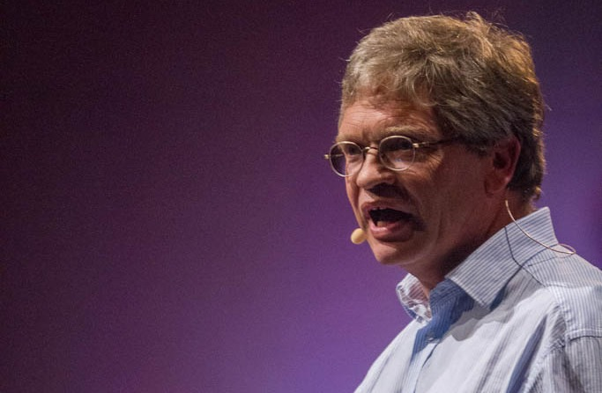
Information
Filter
Hugh Durrant-Whyte

Slide 6
Canonical representation of Gaussian

Slide 7
The standard parameterization of Gaussian:
As the covariance matrix is symmetrical, the two components are the same.
Let’s prove this by programming!

Slide 8
a = 1; b = 2; c = 3; d = 4; e = 5; f = 6; g = 7;
mu = [a b]';
invSigma = [ c d;
d e ];
x = [f g]';
first = mu' * invSigma * x ;
second = x' * invSigma * mu ;
disp(first);
disp(second);
P68
As the covariance matrix is symmetrical, the two components are the same.

Slide 9
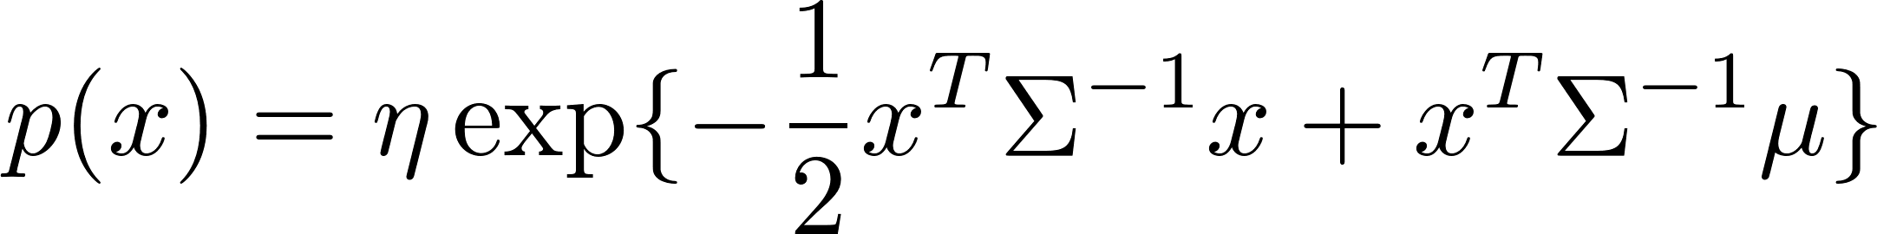
The standard parameterization of Gaussian:

Slide 10
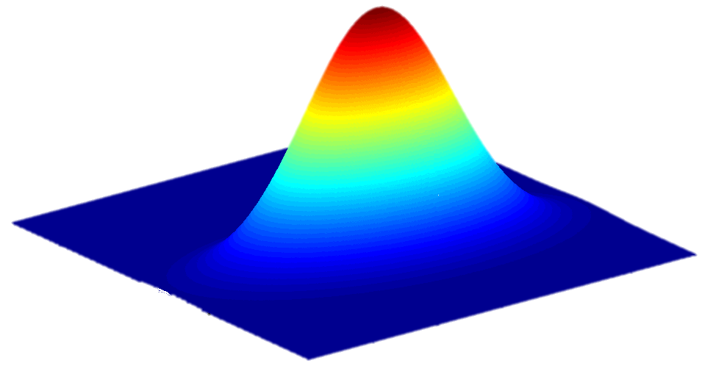
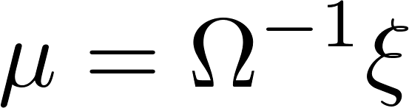
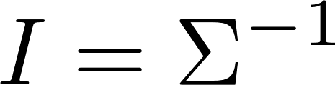
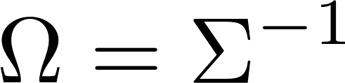
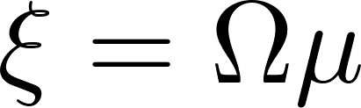
The canonical parameterization of the multivariate Gaussian:
Fisher information
Information matrix
Information vector
Precision matrix

Slide 11
From Linear KF to Linear
Information Filter
Mathematical Derivation of the Information Filter

Slide 12




Kalman filter
Information filter
The dual of KF

Slide 13
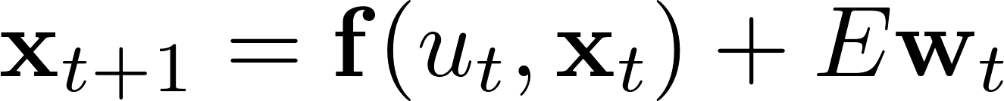
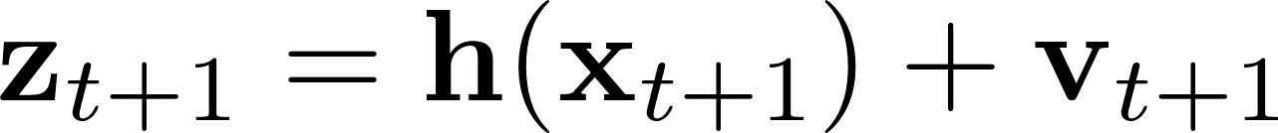
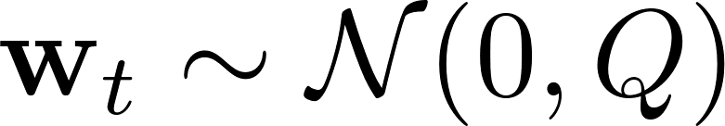
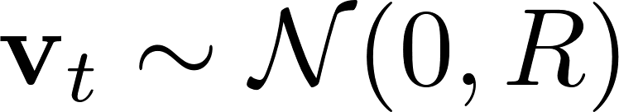

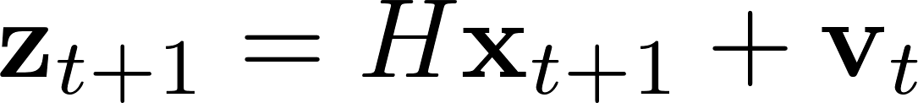
Linear models
Linear motion model
Linear sensor model

Slide 14
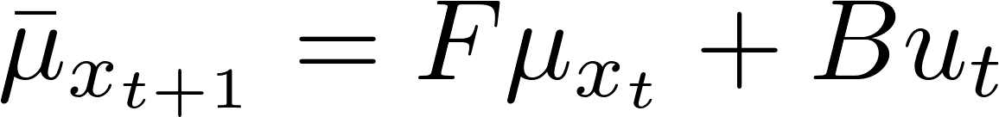
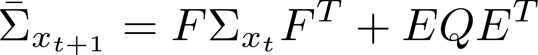
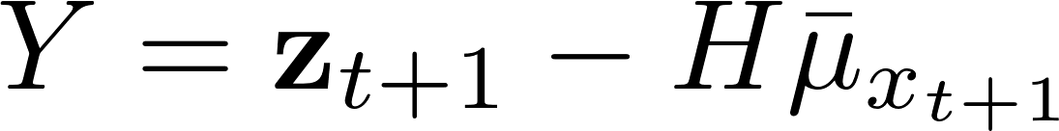
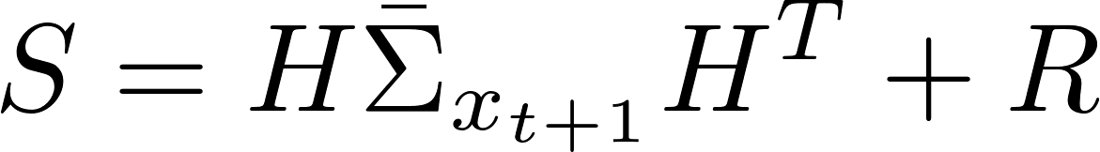
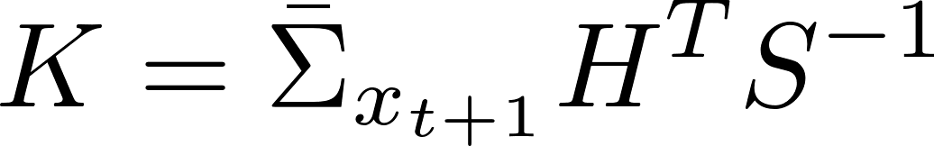

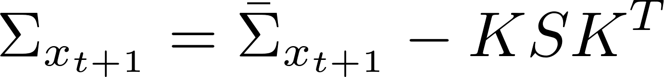
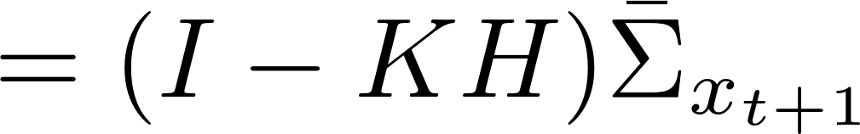
Prediction
Update
Innovation / Residual
Innovation variance
Kalman gain
Linear Kalman filter

Slide 15
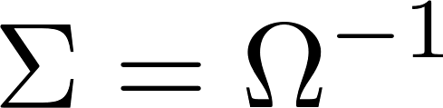
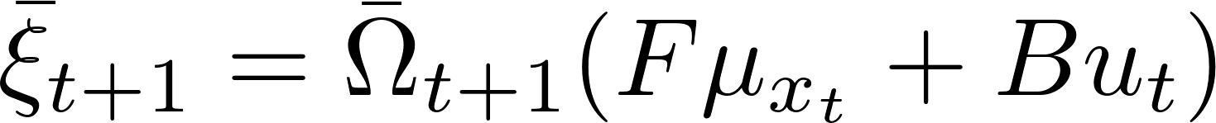
Prediction
Information matrix
Precision matrix
Linear Kalman filter
Information vector
Linear Information filter

Slide 16
Prediction
Information matrix
Precision matrix
Linear Kalman filter
Information vector
Linear Information filter

Slide 17
As to the derivation of linear information filter update, please recall how we got the update routine of linear Kalman filter:

Slide 18
Sensor model

Slide 19
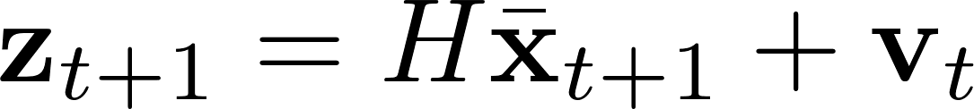
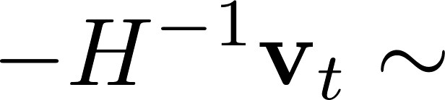

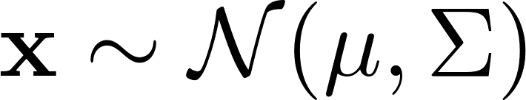
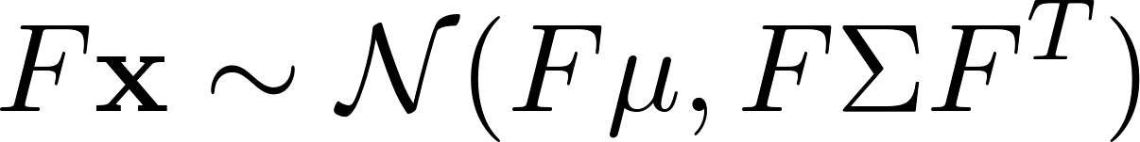
Sensor model

Slide 20
Sensor model

Slide 21
Sensor model
Is the distribution the Posterior?

Slide 22
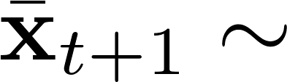
The information about the Posterior can be divided into two pieces:
Indicates the information from involving observations
Indicates the information from prediction

Slide 23
With information matrix (Fisher information), the total information of posterior can be formulated as:
Information matrix

Slide 24
With information matrix (Fisher information), the total information of posterior can be formulated as:
Indicates the information from prediction

Slide 25
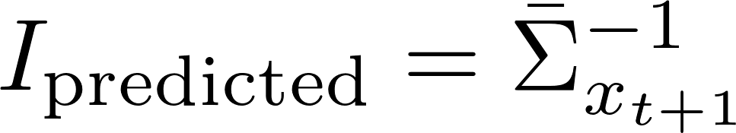
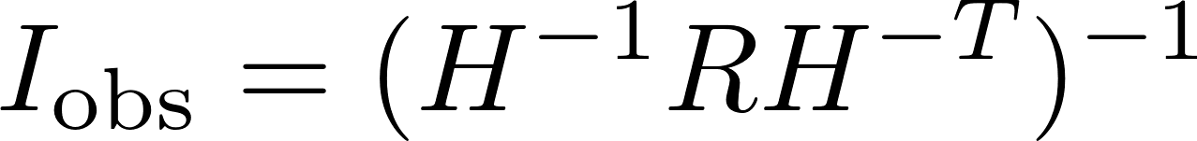
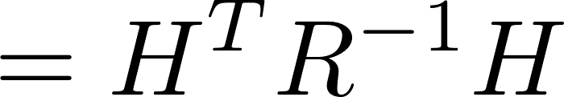
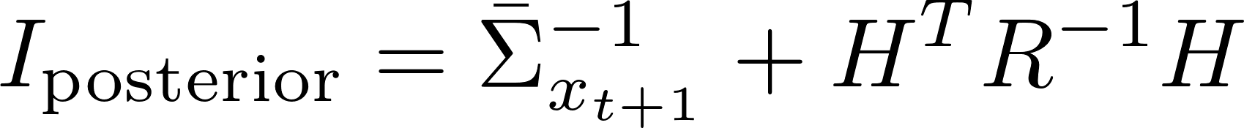
With information matrix (Fisher information), the total information of posterior can be formulated as:
Indicates the information from involving observations

Slide 26
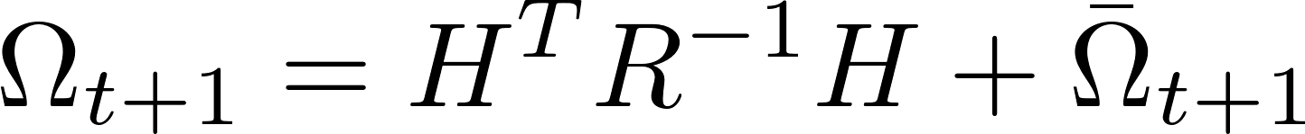


Slide 27
The mean of the posterior is the weighted sum of the mean values of the two Gaussian distributions. The weights are decided by the proportion of information contained in each of the Gaussian distributions.
Indicates the information from involving observations
Indicates the information from prediction

Slide 28
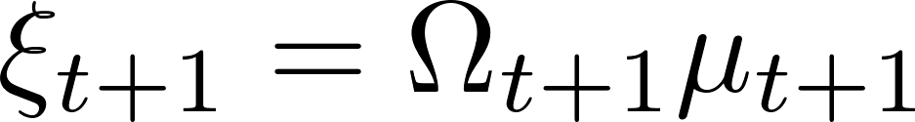
The mean of the posterior is the weighted sum of the mean values of the two Gaussian distributions. The weights are decided by the proportion of information contained in each of the Gaussian distributions.

Slide 29
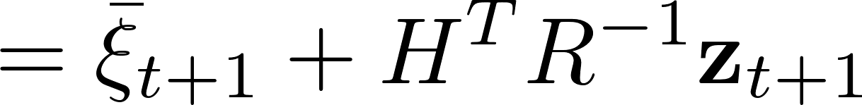

Indicates the information from involving observations

Slide 30
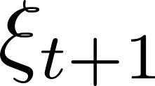
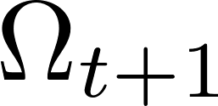
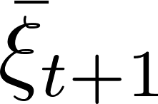
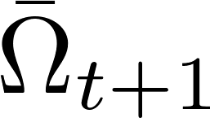
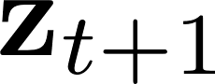
Prediction
Update
Linear Information Filter
State recovery

Slide 31

Implement LIF based on the LKF demo
P39
P66

Slide 32
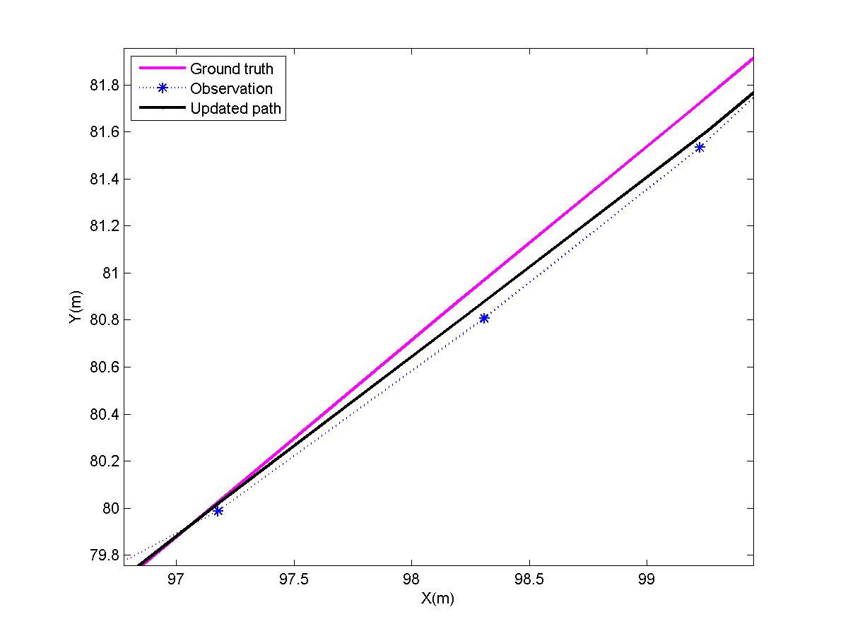
P66

Slide 33
function [xiPred, OmegaPred] = predictLIF(xi, Omega, F, Q, varargin)
%% Linear information filter prediction
if hasE
OmegaPred = eye(xiLen) / ( F / Omega * F' + E * Q * E' );
% Use '/' instead of 'inv' for efficiency
else
OmegaPred = eye(xiLen) / ( F / Omega * F' + Q );
end
if hasU
xiPred = OmegaPred * ( F / Omega * xi + B * u );
else
xiPred = OmegaPred * ( F / Omega * xi );
end
end
P66
Prediction

Slide 34
function [xiPost, OmegaPost] = updateLIF(xi, Omega, z, H, R)
xiPost = H'/ R * z + xi;
OmegaPost = H'/ R * H + Omega;
end
P66
Update

Slide 35
%%
path(path, '../p39'); % For LKF demo
path(path, '../p66'); % For LIF demo
%%
p39
save('lkftime.mat', 'timePredLKF', 'timeUpdateLKF');
%%
p66
save('liftime.mat', 'timePredLIF', 'timeUpdateLIF');
%%
clear all;
load lkftime.mat
load liftime.mat
P67
Compare the time costs
The NAÏVE linear information filter is generally more computationally expensive than LKF!

Slide 36
%%
updateStart = tic;
[xi, Omega] = updateLIF(xi, Omega, zTrue(:,i), H, R);
%% State recovery
muPost(:,i) = Omega \ xi;
timeUpdateLIF(i) = toc(updateStart);
P67
Intel Core i5-2450M @ 2.50GHz, DDR3 1333MHz 8G
Compare the time costs
The time cost of state recovery is also taken into account.

Slide 37
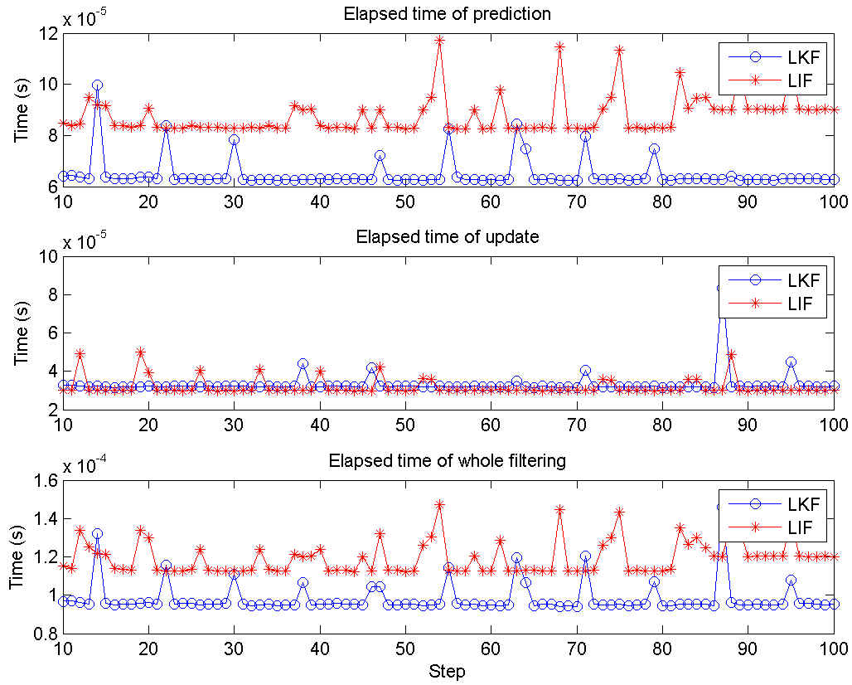
P67

Slide 38
From Linear IF to Extended IF
Mathematical Derivation of the Extended Information Filter

Slide 39
General Nonlinear models
Nonlinear motion model
Nonlinear sensor model

Slide 40
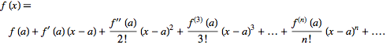
Taylor Expansion
A Taylor series is a series expansion of a function about a point. A one-dimensional Taylor series is an expansion of a real function f(x) about a point x=a is given by

Slide 41
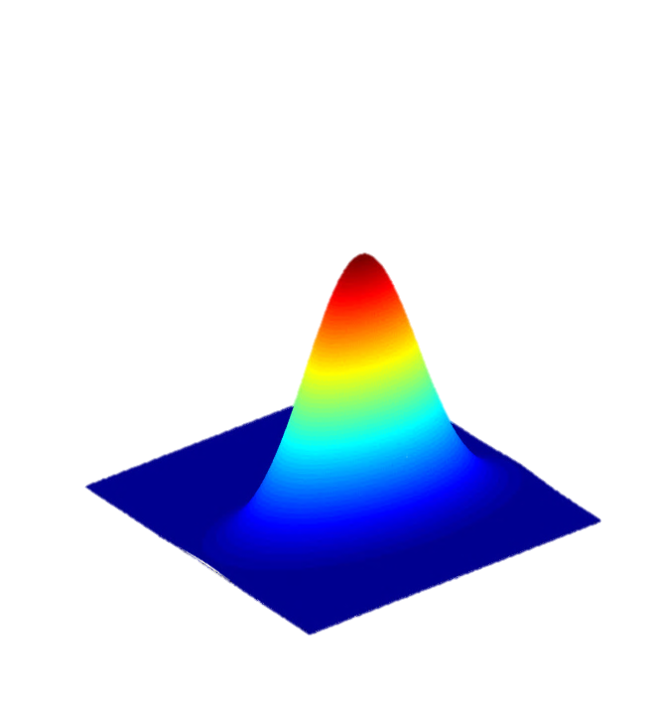
Mean + Covariance

Slide 42


Prediction
Linear Information filter

Slide 43
Prediction
Linear Information filter

Slide 44
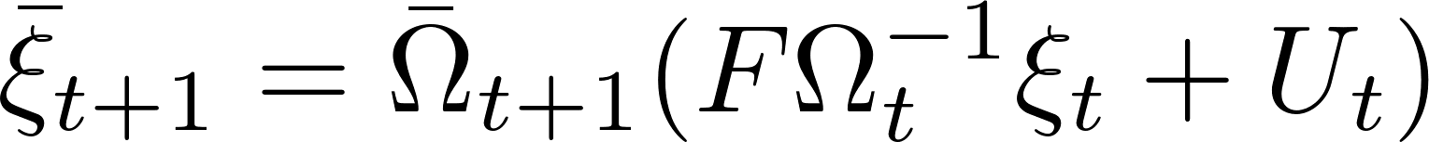
Prediction
Linear Information filter

Slide 45
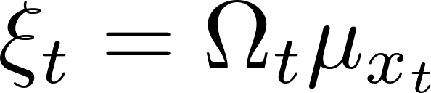
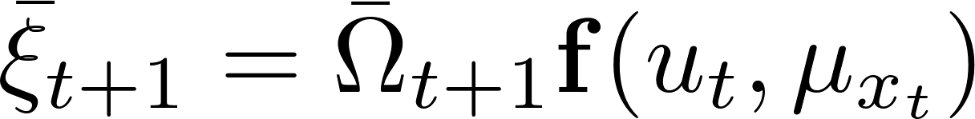
Prediction
Linear Information filter

Slide 46
Mean + Covariance

Slide 47

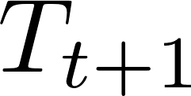
Update
Linear information filter

Slide 48
Update
Linear information filter

Slide 49
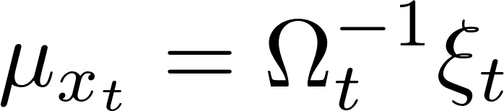
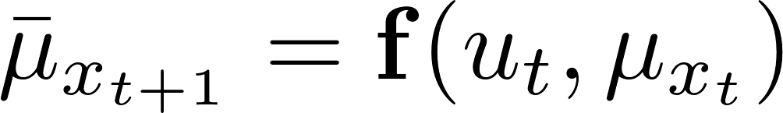
Prediction
Update
Extended Information Filter

Slide 50
Prediction
The need to recover the sate estimate and state prediction stem from:
Jacobian matrix calculation
The system is represented by state vector

Slide 51
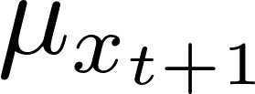
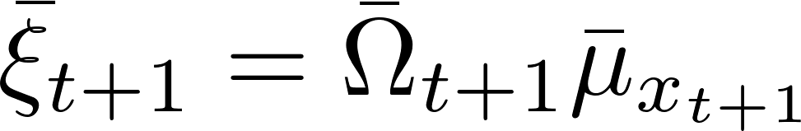

Prediction
Update
Extended Information Filter
(The optimized routine)

Slide 52

Covariance matrix
Implies how uncertain the estimate is
Initialized as infinite
Information matrix
Implies how certain the estimate is
Initialized as zero
The information filter tends to be numerically more stable than the Kalman filter in many of the robotics applications.

Slide 53
Information filter enables a robot to integrate information without immediately resolving it into probabilities.
The information matrix and information vector in measurement update are additive.
This can be of great advantage in complex estimation problems, involving hundreds or even millions of variables.
It naturally fits multi-robot problems which often involve the integration of sensor data collected decentrally.
Update

Slide 54

A primary disadvantage of the EIF is the need to recover a state estimate in the update step
Further matrix inversions are required for the prediction step of the information filters.
The EKF does not involve the inversion of matrices of comparable size.
For high dimensional state spaces, the information filter is generally believed to be computationally inferior to the Kalman filter.
This is one of the reasons why the EKF has been vastly more popular than the EIF.
Prediction

Slide 55
Information filters can be thought of as graphs
States are connected whenever the corresponding off-diagonal element in the information matrix is non-zero.
Sparse information matrices correspond to sparse graphs; in fact, such graphs are commonly known as Gaussian Markov random fields.

Slide 56
Implement EIF based on the EKF demo (bearing-only)
P54
P69

Slide 57

P69

Slide 58
function [muPred, xiPred, OmegaPred] = predictEIF(...
mu, Omega, u, motionModel, F, Q)
n = length(mu);
muPred = motionModel(mu, u);
OmegaPred = eye(n) / (F / Omega * F' + Q);
xiPred = OmegaPred * muPred;
end
P69
Prediction

Slide 59
function [muPost, OmegaPost, xiPost] = updateEIF(mu, Omega, xi,...
sensorModel, sensorPos, z, H, R, hasAngle, idxAngle)
Y = z - sensorModel(mu, sensorPos) + H * mu;
if hasAngle
Y(idxAngle) = piTopi(Y(idxAngle));
end
xiPost = H' / R * Y + xi;
OmegaPost = H' / R * H + Omega;
muPost = OmegaPost \ xiPost;
P69
Update

Slide 60
for i = 1 : step
if i ~= 1
u = relMotion(:, i-1);
predStart = tic;
F = p54.jacobF(mu, u);
[mu, xi, Omega] = predictEIF(mu, Omega, u,...
@p54.motionModel, F, Q);
timePredEIF(i) = toc(predStart);
%
end
H = p54.jacobH(mu, sensorPos);
updateStart = tic;
[mu, Omega, xi] =...
updateEIF(mu, Omega, xi, @p54.sensorModel, sensorPos,...
zTrue(:,i), H, R, true, 1);
timeUpdateEIF(i) = toc(updateStart);
end
P69

Slide 61
Initalization
Although the information matrix can be in principle initialized to zero, the too small numerical initialization, e.g. 1e-8 * eye(3), might result in closely singular matrices during prediction or update, then the warnings like ‘Matrix is close to singular or badly scaled. Results may be inaccurate’ will be emitted.
As a rule of thumb, the information matrix should be initialized reasonably, the elements are not necessarily too close to zero. In p69, I feed ‘OmegaInit’ 1e-3 * eye(3) which implies that we are somewhat sure the robot’s initial state as the first batch of raw observations is adequately for ‘OmegaInit’ determination.
Similarly, the robot state can not be initialized to [0, 0, 0] to avoid the bad condition number with respect to matrix inversion.
P69

Slide 62
Stability
The EIF demo shown in p69 seems to be more stable than the analogous EKF demo implemented in p54…
Strict performance comparison, as the future work, is needed to draw the above conclusion.
P69

Slide 63
Implement EIF based on the EKF demo (bearing-range)
P57
P70

Slide 64




Motion model
nonlinear

Slide 65




Measurement
model
nonlinear
Calculate the Jacobians by programming!

Slide 66

P70

Slide 67
reusability
Thanks to p57 and p69, the EIF demo with range & bearing sensor model can be built within 10 minutes!
It proves, once again, how important to keep reusability in your mind when programming!
The models and filtering functions are just borrowed from the existing codes by involving their path .
p70.m
p70InitFigure.m
P70

